Slide 1
Fedora Badges
Presented by
Ross Delinger
Summer Intern
Licensed under Creative Commons 3.0

Slide 2
Who am I?
2nd year Computer Science Student
sysadmin for Computer Science House
Redhat intern working out of the RIT FOSSBox
(An Applied Research lab Focusing on Free and Open Source Software & Open Web Technologies)

Slide 3
What is Fedbadges?
+

Slide 4
Fedora Infrastructure
Bodhi
MediaWiki
IRC
Koji
FAS
etc..

Slide 5
What are Open Badges?
An open and federated achievement system.
Anyone can create, issue, display, and earn Open badges

Slide 6
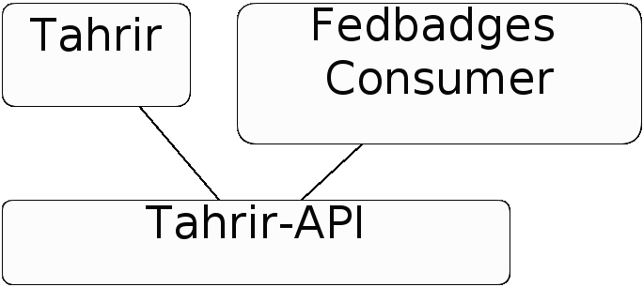
The Fedbadges Stack

Slide 7
Tahrir-API
https://github.com/rossdylan/tahrir-api

Slide 8
Details
Simple API for interacting with the Tahrir database
Uses sqlalchemy as a backend so any compatible database will work.
The basis for both Tahrir, and the fedbadges consumer

Slide 9
Example: Issuing a badge
tahrir = TahrirDatabase(dburi)
tahrir.add_person(email)
tahrir.add_assertion(badge_id, email, issued_on)$

Slide 10
Fedbadges Consumer
https://github.com/rossdylan/fedbadges

Slide 11
Details
Plugin for fedmsg (Fedora real time messaging system)
Issues badges based on messages from fedmsg
Uses tahrir-api to talk to the database
Provides a simple way to expand and make different consumer for different types of badges.

Slide 12
Tahrir
https://github.com/ralphbean/tahrir

Slide 13
Details
Python web application
Uses the pyramid framework
Displays awarded badges
Bridges local badges back to the wider Open Badges Ecosystem
Uses OpenID for authentication

Slide 14
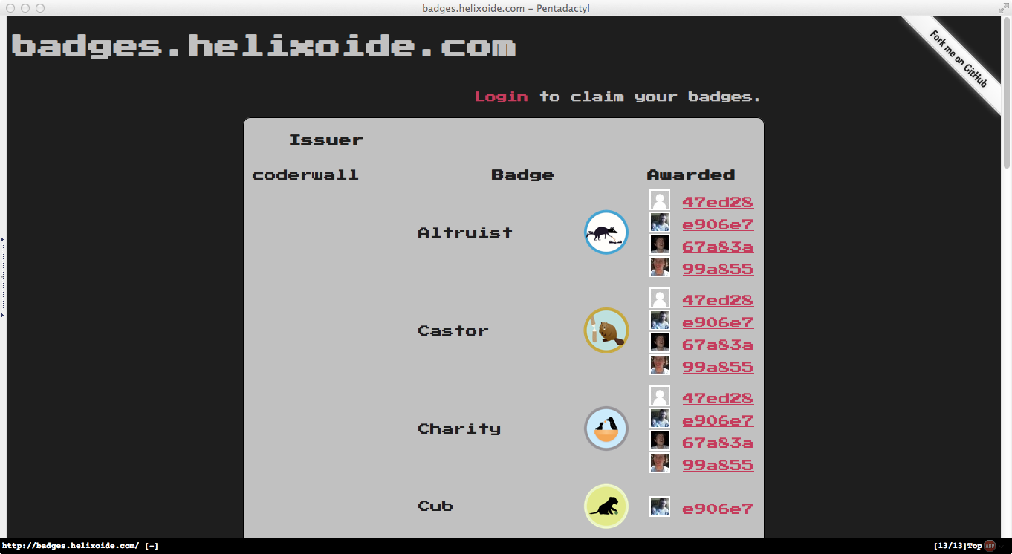
Tahrir Screenshots

Slide 15
Summary
Tahrir Web app
Pyramid web app
Displays badges
Interacts with Open Badges
Tahrir-API
Uses sqlalchemy
basis of fedbadges stack
Fedbadges Consumer
Plugins into fedmsg
Awards badges based on realtime messages

Slide 16
Questions?
Contact:
rdelinger@redhat.com
Licensed under Creative Commons 3.0

Slide 17
Thanks to...
Ralph Bean
Luke Macken
Tom Callaway
Remy DeCausemaker
Steven Jacobs

